Slide 1



Yahusha
“Lost? and Found!”

Slide 2

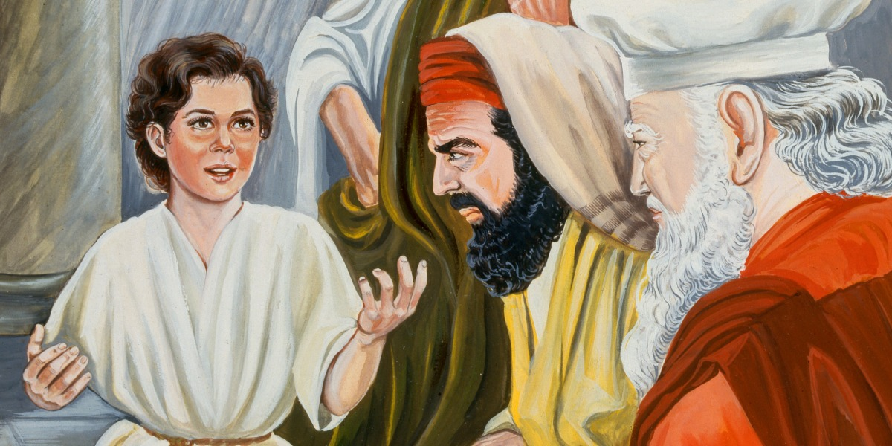
Yahusha at age 12 revealed Responsibility & Statement!

Slide 3
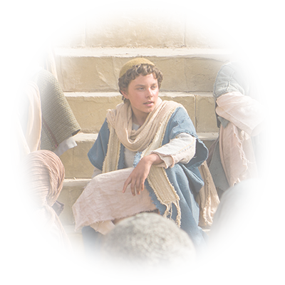
Yahusha, at the age of 12 years,
positively fulfilled prophecy.
(Come in My Name.)
Yahusha, at the age of responsibility,
wasted no time in exposing His mission on this earth.
When Yahusha, being next to death declared – “It has been accomplished,” WHAT WAS IT that was accomplished?
Read John 5:30 (NEXT SLIDE)

Slide 4
I can of mine own self do nothing: as I hear, I judge: and my judgment is just; because I seek not mine own will, BUT THE WILL OF THE FATHER
which hath sent me.
John 5:30 KJV
That - Which Was Accomplished!

Slide 5
Does –
THE WILL of Yahuah
include
CALENDAR
?
Creation!
Flood!
Manna!
Quail
The Passion Week!
Exodus!
Sinai!

Slide 6
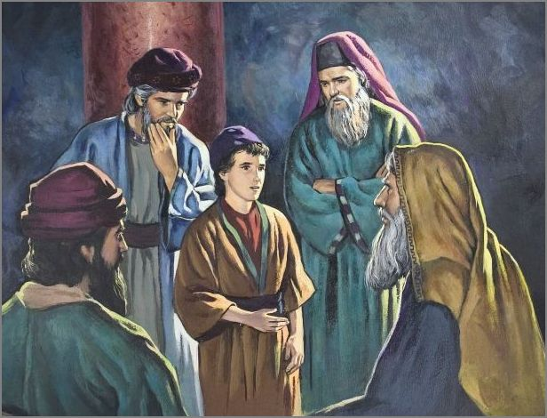
At 12 years of age, a Divinely controlled
event, caused Yahusha to be speaking
with the clergy in the Tabernacle on
the 3rd day, which FOLLOWED the
Feast of the Yahudim (Jews).
Luke 2 is written with very intentional descriptions for
this tender moment of startling importance.
Take note of Luke’s SPECIFIC documentation for the required
STANDARDS around these events pertaining to Yahusha.

Slide 7
Luk 2:21 And when eight days were completed for Him to be circumcised, His Name was called יהושע [Yahusha], the Name given by the messenger before He was conceived
in the womb. {Lev 12:3}
Luk 2:22 And when the days of her cleansing according to the Torah of Mosheh were completed, they brought Him to Yerushalayim to present Him to יהוה [Yahuah] –
Luk 2:23 as it has been written in the Torah of יהוה, “Every male who opens the womb shall be called set-apart to יהוה”
Luk 2:24 and to give an offering according to what is said in the Torah of יהוה, “A pair of turtledoves or two young pigeons.”

Slide 8
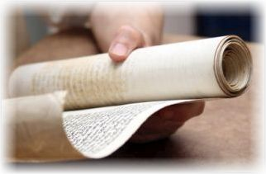
Luke 2:27 And he came in the Spirit into the Set-apart Place. And as the parents brought in the Child יהושע,
[Yahusha] to do for Him
according to the usual practice of the Torah,

Slide 9
Luk 2:39 And when they had accomplished all matters according to the Torah of יהוה [Yahuah], they
returned to Galil, to their city Natsareth.
Note: Up to this point Luke clearly delineates the modus operandi of event requirements as they
pertain to Yahusha.
Everything recorded to this point had a
Torah requirement & fulfillment.
Let us keep our eyes wide open, and our minds even more open and ready for discernment.

Slide 10
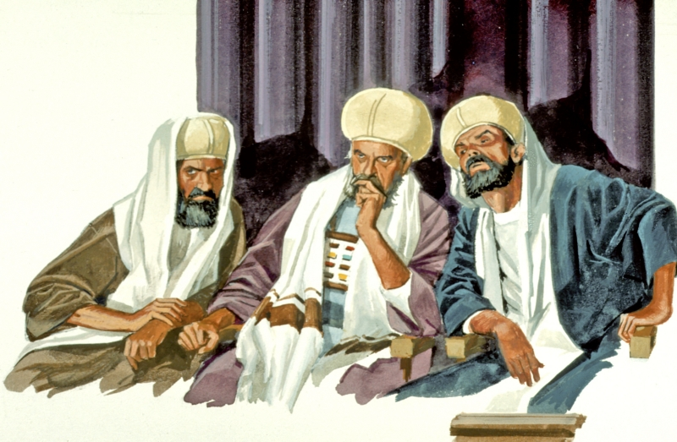
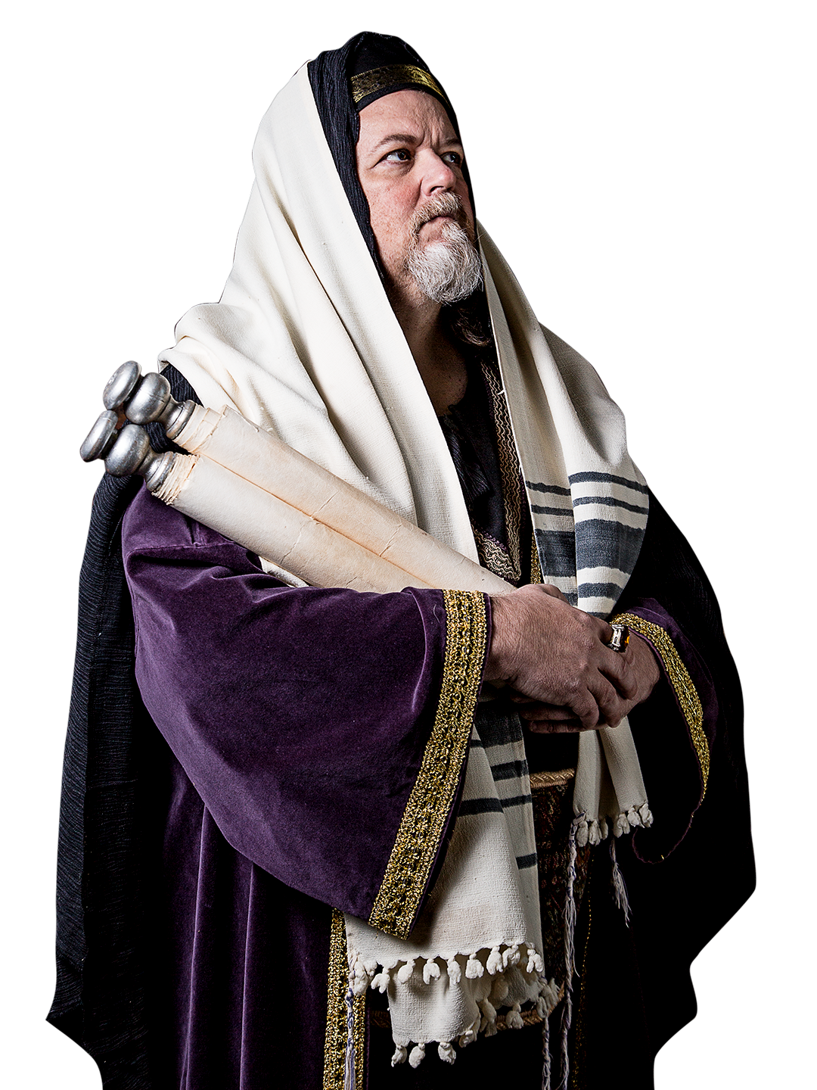
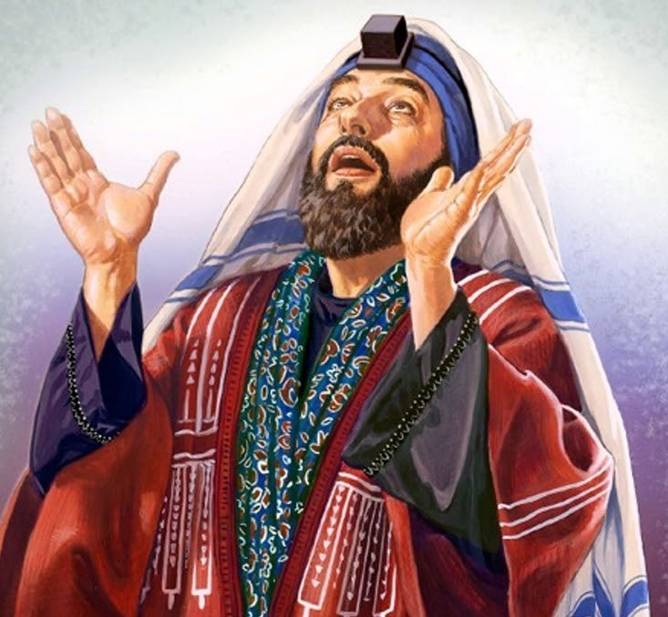
Luk 2:41 And His parents went to Yerushalayim every year at the Festival of the Passover.
“the Festival”
WHO’S Festival was this?
Why did Luke not directly connect Yahuah’s Name to this Festival as with other specified entities?
Why did Luke not, as his custom was, inform us of pertinent Torah requirements and fulfillments?

Slide 11
Luk 2:42 And when He was twelve years old, they went up to Yerushalayim according to the practice of the festival.
According to Luke’s record of documentation, is it not strange that Luke did not say – “according to the Torah” – when citing this festival?
The age of accountability.
“the Festival of the Pesach” Luke 2:41
Do these terms seem a bit unusual in terms of Luke’s former recordings?
Let’s do a comparison.
“according to the practice of the Festival” Luke 2:42

Slide 12
Yahuah’s Standards
WHAT DIFFERENCE activated Luke to alter his documentation to a dissimilar informative format?
according to the Torah
as it has been written
in the Torah
“the Festival of the Pesach”
according to what is said
in the Torah
“according to the practice of the Festival”
the usual practice
of the Torah

Slide 13
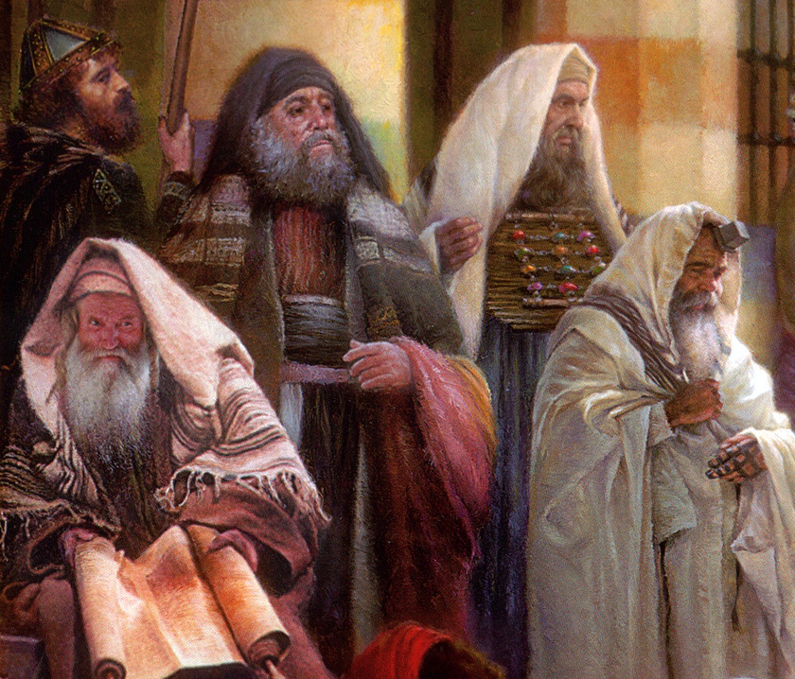

?
As Luke did not designate
this specific Festival as
~ that of Yahuah ~
THEN
WHO’S
FESTIVAL
WAS IT?

Slide 14
Considering that Miryam had a good idea of just who her son Yahusha was (and is), carefully consider this next revelation from the Scriptures and ask yourself –
HOW, & equally as important, WHY …
1. What extremely unusual event occurred at this Festival concerning the welfare of Yahusha?
2. Why did Luke not specify this timeframe as – “the days of Yahuah?”
Luke 2:43 When they had accomplished the days, as they returned,
the Child יהושע [Yahusha] stayed behind in Yerushalayim.
Not too unusual thus far … BUT …

Slide 15


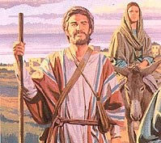
Luke 2:43 continues -
And His parents did not know it… Luke 2:43

Slide 16
Was it pure chance that Miryam and Yoseph on the
start of their long journey home, just happened to
“forget” and leave Yahusha behind?
Was Ha Satan hoping that Yahusha was lost forever?
OR –
Is it possible that Yahuah purposely caused - (blocked) the knowledge of Yahusha being left behind,
to not enter the minds of His earthly parents?

Slide 17
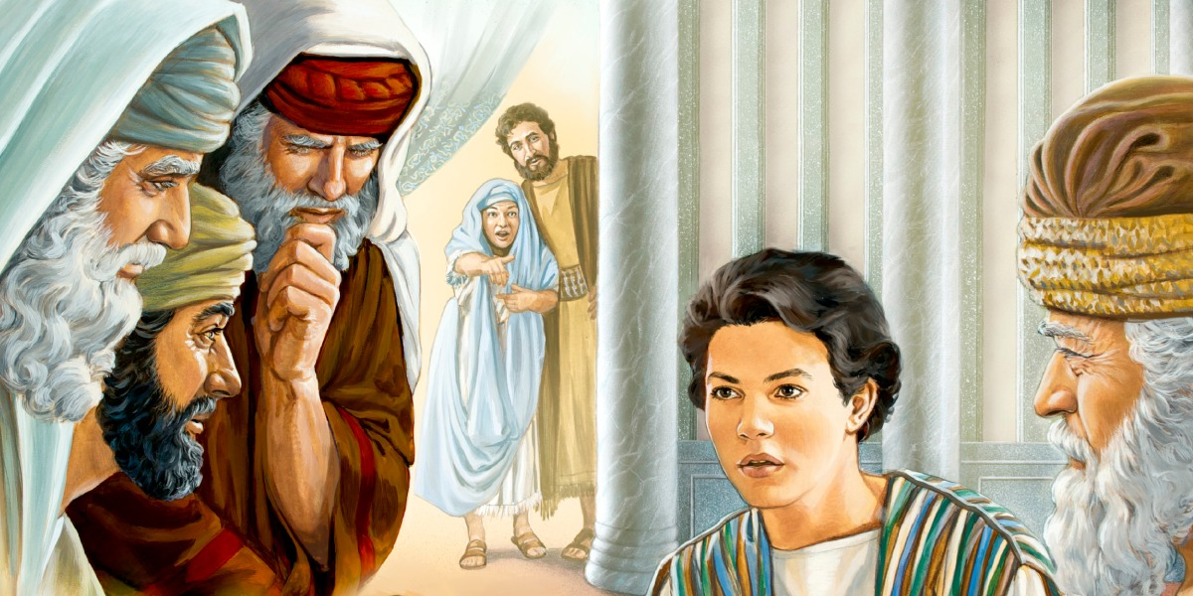
Is it possible that being left behind and found
3 days later in the Tabernacle,
might fulfill some
DIVINE STATUTES?

Slide 18

What if there were
two different calendars in this time,
that were in operation at the same time?
What if the Covenant Count found
from Gen 1 to Exo 24:11
and a lunar based, fully adjustable
(John 7:6 – see “ready” #G2092)
calendar were operating at the same time?
Would anyone be interested in a COMPARISON of both these calendars for answers?

Slide 19
Important Comparison Info #1:
How do we know that it was the crescent moon that determined times back then and not another phase of the moon?
In all research thus far and especially that of
Julian Morgenstern, it is repeatedly recorded that the crescent moon was the specific identity for the cause of determining time.

Slide 20
Important Comparison Info #2:
How are we able to determine the lunar based year all the way back to CE 12?
The Lunar Metonic Cycle has a
19 year cyclical pattern.
It is here that the phases of the moon
can be recorded.
See next slide -

Slide 21
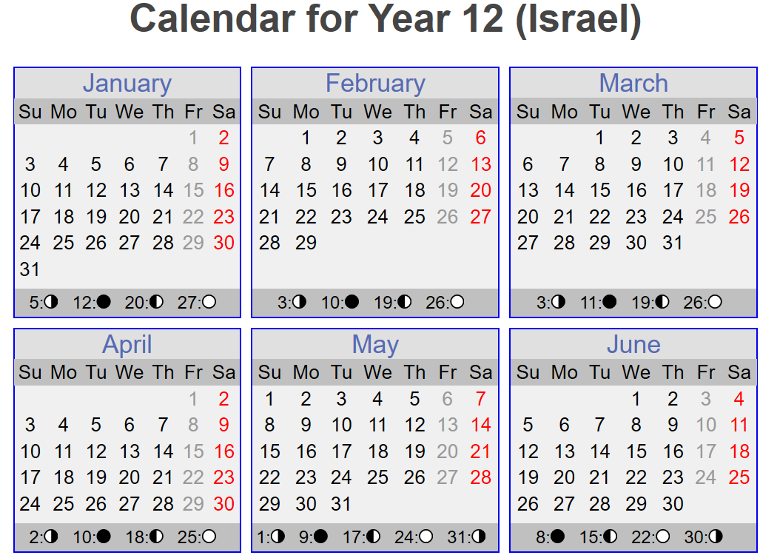
Conjunction
Crescent moon/ New Month Day
Conjunction
Tequfah
13:53 hrs

Slide 22
If one wants more information about the
600 years before Yahusha arrived on this earth, you will find the book –
Hebrew Union College Annual (1935) Chapter #1,
The Calendars of Ancient Israel -
more interesting than can be described.
OK! With that information,
we will proceed with the
comparison of Calendars.

Slide 23
CE 12 Yahusha in the Tabernacle – 3 days “LATE”?
CYCLES
WEEK MONTH
The Lunar year in CE 12.
The lunar year, according to the crescent moon,
had started here.
Again: Notice the 1st cycle of the 1st month was well BEFORE the Tequfah!
1st New Moonth Day (Mar 13) 1
2nd (14) 2
3rd (15) 3
4th (16) 4
5th (17) 5
6th (18) 6
7th (19) 7
1st (20) 8
Pre-Tequfah!
(Equinox)

Slide 24
CE 12 Yahusha in the Tabernacle – 3 days “LATE”?
CYCLES
WEEK MONTH
Please note carefully that Julian Morgenstern’s documentation records multiple times that the 1st of the 1st Lunar month started before the Tequfah in this timeframe!
1st New Moonth Day (Mar 13) 1
2nd (14) 2
3rd (15) 3
4th (16) 4
5th (17) 5
6th (18) 6
7th (19) 7
1st (20) 8
Pre-Tequfah!
(Equinox)
When is the Tequfah (Equinox)?

Slide 25
Lunar Calendar CE 12
Covenant Calendar
The Tequfah event occured 10 cycles after the Lunar year had begun. Note the 3rd cycle of the week!
Approximately
- 2 PM
1st (Mar 20) 8
2nd (21) 9
3rd (22) 10
4th (23) 11
3rd Tequfah ! 365
4th New Year Day (20) 1
By the 4th cycle of the week, the cycle after the Tequfah
(Equinox) event, 10 cycles had elapsed within the lunar calendar.
This created a 10 cycle difference between the Calendar of Yahusha (My Time John 7:6) and the lunar (counterfeit) calendar!

Slide 26
Lunar Calendar CE 12
Covenant Calendar
CYCLES
WEEK MONTH
Approximately - 2 PM
The # of Lunar days before the Tequfah!
1st (20) 8
2nd (21) 9
3rd (22) 10
4th (23) 11
5th (24) 12
6th (25) 13
7th (26) 14
3rd Tequfah ! 365
4th New Year Day 1
5th 2
6th 3
7th Sabbath 4
Lunar
Passover
It is from this point, New Year Day, that Covenant Count begins counting 14 cycles towards Passover.
Yet the Lunar Calendar had already achieved 14 cycles in the first month! THEIR LUNAR Passover was here!

Slide 27
Lunar Calendar CE 12
First – have you noticed that the Lunar Passover was on a 7th day Sabbath? Remember that Passover by Covenant Count with Joshua entering Canaan,
was also on a 7th Day Sabbath. ☺
WEEK (Cycles) MONTH
7th Lunar Passover (26)14
1st (27) 15
2nd (28) 16
3rd (29) 17
4th (30) 18
5th (31) 19
6th (Apr 1) 20
7th (2) 21
1st (3) 22
2nd (4) 23
3rd (5) 24
… at “the Festival” of the Pesach.
… according to “the practice of” the Festival. (Luke 2:42b & 43c)
The yellow highlights are the Lunar Feast of Unleavened Bread dates.
“On the third cycle”
1
“And it came to be that after three days that they found Him in the Migdash, sitting in the midst of the teachers, both listening to them and asking questions.” (Luke 2:46)
2
3

Slide 28
Lunar Calendar CE 12
WEEK (Cycles) MONTH
It was the third cycle of the week and Yahusha was found in the
Migdash (Tabernacle) by His distraught earthly parents.
And having seen Him they were amazed. And His mother said to Him, “Ben [Son] why have you done this to us? See, Your father and I have been anxiously seeking you! Luke 2:48
To which Yahusha answered -
7th (26)14
1st (27) 15
2nd (28) 16
3rd (29) 17
4th (30) 18
5th (31) 19
6th (Apr 1) 20
7th (2) 21
1st (3) 22
2nd (4) 23
3rd (5) 24
“On the third cycle”
1
2
3

Slide 29
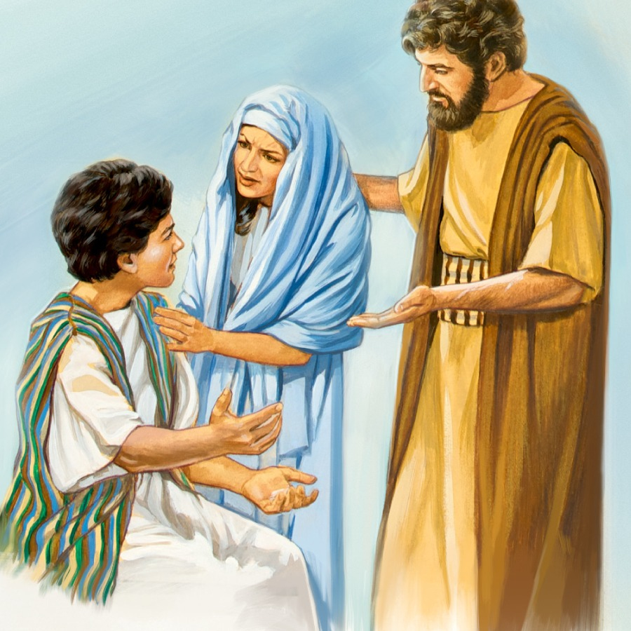
Lunar Calendar CE 12
And He said unto them, “Why were you seeking me?... Luke 2:29
Was Yahusha insinuating that they should have very well known of His whereabouts?
Not because He was lost, BUT BECAUSE -
WEEK (Cycles) MONTH
7th (26)14
1st (27) 15
2nd (28) 16
3rd (29) 17
4th (30) 18
5th (31) 19
6th (Apr 1) 20
7th (2) 21
1st (3) 22
2nd (4) 23
3rd (5) 24
“On the third cycle”
Wyste ye not, that I must go about my fathers businesse?” Luke 2:49 Bishop’s 1538
1
2
3

Slide 30
… that I had to be in My Father’s house?” Luke 2:49 NASB
It was the 3rd cycle in that highly specific week!
What is the very sad documentation in the next verse? (Luke 2:50)
But they did not understand THE WORD which He spoke to them.
Yahusha’s earthly parents
They did not understand the counterfeit deception of the lunar calendar, that had quietly usurped their allegiance to Yahuah and
had misplaced & diverted their worship to an evil god – Ha Satan!
1
2
3
did not understand the MelchiTzedek Administration!

Slide 31
… I must go about My Father’s business?” Luke 2:49 KJV
They did not understand that Yahusha, The Word, was preparing to be the next MelchiTzedek Kohen Ha Gadol and must execute
Exo 23:14-17 perfectly!
WHY must Yahusha observe Exo 23:14-17
EXACTLY, INCLUDING PROPER TIMING?
Very briefly: because Exo 23:14-17 is within the Everlasting Covenant which was agreed to 3 times by the Hebrew nation,
before it was blood ratified - then sealed with a meal (Exo 24:1-11), -
FOR ETERNITY! Yahusha MUST observe the Feast of Yahuah,
with absolute impeccable timing! Nothing short of it!
1
2
3
High Priest

Slide 32
Yet the earthly parents of Yahusha had been deceived & misled through the insidious assault of lunar teachings from generations past!
The words of Yahusha – “Do you not know…” (Luke 2:49) reveals
a stunning fact that they – Yoseph and Mary – did not know
about the timing of the Covenant Calendar of Yahuah!
They did not know the qodesh timing of the Feasts!
They did NOT start their new year according to the Tequfah!
The lunar system they followed, “according to the practice of the festival” (Luke 2:42) had them on an entirely different schedule.
1
2
3

Slide 33
What did Yahuah say about the lunar system of determining time?
Isa 1:12 “When you come to appear before Me, who has required this from your hand, to trample My courtyards? [desecrate & profane]
:13 “Stop bringing futile offerings, incense, it is an abomination to Me. New Moons, Sabbaths, the calling of meetings – I am unable to bear unrighteousness and assembly.
:14 “My being hates your New Moons and your appointed times, they are a trouble to Me, I am weary of bearing them.
:15 “And when you spread out your hands, I hide My eyes from you; even though you make many prayers, I do not hear. Your hands have become filled with blood.
:16 “Wash yourselves, make yourselves clean; put away the evil of your doings from before My eyes. Stop doing evil!

Slide 34

Do you think Yahusha received that memo from Isaiah?
It’s time to compare Covenant Calendar
to the Lunar calendar!
Exactly what was Luke trying to tell us when he documented the “3 days late?” Was it just “3 days” as it sounds?
Or, did Luke covertly identify - The 3rd Cycle of a special Covenant Calendar Week (upon which was the … )?
See for yourself, and you decide!
1
2
3
What is with that #3?

Slide 35
Lunar Calendar CE 12
The Refresher Slide
WEEK (Cycles) MONTH
7th Passover (?) (26)14
1st (27) 15
2nd (28) 16
3rd (29) 17
4th (30) 18
5th (31) 19
6th (Apr 1) 20
7th (2) 21
1st (3) 22
2nd (4) 23
3rd (5) 24
(Lunar) Week of Unleavened Bread
Does that #3 look like it needs to burst, revealing important information about WHO Yahusha is?
“On the third cycle”
1
And He said unto them, “Why were you seeking me? Wyste ye not, that
I must go about my fathers businesse?” Luke 2:49 Bishop’s 1568
2
3

Slide 36
At this point the question can be asked, - Just who is this Yahusha and what should be His course of actions according to His statements?
“I can of mine own self do nothing: as I hear, I judge: and my judgment is just; because I seek not mine own will, but the will of the Father which hath sent me.” John 5:30
“Think not that I am come to destroy the law, or the prophets: I am not come to destroy, BUT TO FULFIL. ” Matt 5:17
Can we expect Yahusha to observe the Covenant Calendar of Yahuah
in spite of all other instruction?
1
2
3

Slide 37
Is it possible that Yahusha at the age of responsibility, (12 years old),
made a BOLD STATEMENT concerning Him following
the Will of His Father? Consider His words of intentions –
This and other verses make it quite clear that Yahusha’s full intention was to do the will of His Father – Yahuah.
Is Covenant Calendar within this intention? We shall see!
We will restart the Covenant Calendar so there is no mistake in counting!
John 4:34 יהושע said to them, “My food is to do the desire of Him who sent Me, and to accomplish His work.
John 6:38 “Because I have come down out of the heaven, not to do My own desire, but the desire of Him who sent Me.

Slide 38
Lunar Calendar CE 12
Covenant Calendar
CYCLES
WEEK MONTH
Approximately - 2 PM
1st (20) 8
2nd (21) 9
3rd (22) 10
4th (23) 11
5th (24) 12
6th (25) 13
7th (26) 14
3rd Tequfah ! 365
4th New Year Day (20) 1
5th (21) 2
6th (22) 3
7th (23) 4
1st (24) 5
2nd (25) 6
3rd (26) 7
Lunar Passover!
Restarting the calendar so there is no mistaking!

Slide 39
Lunar Calendar CE 12
A “Refresher” Slide
WEEK (Cycles) MONTH
The TRADITIONAL Feast of the Yahudim, (Luke 2:42,43) the Passover and Unleavened Bread Festival, was finished on the 21st of the 1st lunar month. Yahusha was discovered in the Temple after 3 cycles, ON THE
3RD CYCLE!
7th (26)14
1st (27) 15
2nd (28) 16
3rd (29) 17
4th (30) 18
5th (31) 19
6th (Apr 1) 20
7th (2) 21
1st (3) 22
2nd (4) 23
3rd (5) 24
“On the third cycle” ????????
(Tuesday)
Wyste ye not, that I must go about my fathers businesse?” Luke 2:49 Bishops 1538
1
2
3

Slide 40

Lunar Calendar CE 12
Covenant Calendar
WEEK (Cycles) MONTH
Final cycle of the Lunar U/B Festival
4th (30) 18
5th (31) 19
6th (Apr 1) 20
7th (2) 21
1st (3) 22
2nd (4) 23
3rd (5) 24
4th 8
5th 9
6th 10
7th 11
1st 12
2nd 13
3rd 14
1
2
Passover
3
Abib 14 – Passover!

Slide 41
Is there a Scriptural reason why Yahusha
should be in the Tabernacle on this
particular 3rd cycle of the week?
Deut 16:16 “Three times a year
all your males appear before יהוה your Elohim
in the place which He chooses:
at the Festival of Unleavened Bread,
and at the Festival of Weeks,
and at the Festival of Booths.
And none should appear before יהוה
empty-handed …

Slide 42
Covenant Calendar
HALLELU-YAH!
4th 8
5th 9
6th 10
7th 11
1st 12
2nd 13
3rd 14
Abib 14 – Passover!
1
2
Passover
3
Yahusha was “PRESENTING HIMSELF” in the Tabernacle! On Passover! Exo 23:17!

Slide 43
3rd Tequfah ! 30
Covenant Calendar
4th New Year Day 1
5th 2
6th 3
7th Sabbath 4
1st 5
2nd 6
3rd 7
4th 8
5th 9
6th 10
7th 11
1st 12
2nd 13
3rd 14
“Did you not know…”? (Luke 2:49c)
[HAVE YOU NOT HEARD?]
Luke 2:50
… but they did not understand the Word which He spoke to them.
Even Yahusha’s earthly parents did not understand about the Tequfah!
1
2
3
Passover

Slide 44

Yahusha’s earthly parents were following
the Lunar based calendar which had insidiously displaced the
Covenant Calendar hundreds of years earlier.
People ask – why is there no sign of Yahusha correcting the Calendar
in the Messianic Testament?
THERE IS CALENDAR CORRECTION!!!
If only we would read & study the WORD
as it is WRITTEN!

Slide 45

3rd Tequfah ! 365
Covenant Calendar
4th New Year Day 1
5th 2
6th 3
7th Sabbath 4
1st 5
2nd 6
3rd 7
4th 8
5th 9
6th 10
7th 11
1st 12
2nd 13
3rd 14
My people are destroyed for lack of knowledge:
because thou hast rejected knowledge, I will also reject thee, that thou shalt be
no priest to me: seeing thou hast forgotten the law of
thy Elohim, I will also forget
thy children. (Hos 4:6)
HAVE YOU NOT HEARD?
1
2
3
Passover

Slide 46
3rd Tequfah ! 365
Covenant Calendar
4th New Year Day 1
5th 2
6th 3
7th Sabbath 4
1st 5
2nd 6
3rd 7
4th 8
5th 9
6th 10
7th 11
1st 12
2nd 13
3rd 14
“Remember the MOON
of Mosheh???
HAVE YOU HEARD?
No!
1
2
3
Passover

Slide 47
3rd Tequfah ! 365
Covenant Calendar
4th New Year Day 1
5th 2
6th 3
7th Sabbath 4
1st 5
2nd 6
3rd 7
4th 8
5th 9
6th 10
7th 11
1st 12
2nd 13
3rd 14
Mal 4:4
“Remember
the Torah
of Mosheh, My servant, which I commanded him in Ḥorĕḇ for all Yisra’ĕl – laws and right-rulings.
HAVE YOU NOT HEARD?
1
2
3
Passover

Slide 48
3rd Tequfah ! 365
Covenant Calendar
4th New Year Day 1
5th 2
6th 3
7th Sabbath 4
1st 5
2nd 6
3rd 7
4th 8
5th 9
6th 10
7th 11
1st 12
2nd 13
3rd 14
Deut 18:18 ‘I shall raise up for them a Prophet like you out of the midst of their brothers. And I shall put My Words in His mouth, and He shall speak to them all that I command Him.
:19 And it shall come to pass, that whosoever will not hearken unto My words which he shall speak in My name, I will require it of him.
HAVE YOU NOT HEARD?
“Do you not know…” Luke 2:49
1
2
3
Passover

Slide 49
3rd Tequfah ! 365
Covenant Calendar
4th New Year Day 1
5th 2
6th 3
7th Sabbath 4
1st 5
2nd 6
3rd 7
4th 8
5th 9
6th 10
7th 11
1st 12
2nd 13
3rd 14
… “Do you not know that I must be about the matters of My Father?”
Yahusha spoke these
WORDS of the Father.
Yahusha SET THE EXAMPLE of abiding by the Covenant Calendar.
HAVE YOU NOT HEARD?
1
2
3
Passover

Slide 50
3rd Tequfah ! 365
Covenant Calendar
Deut 16:11 “And you shall rejoice before יהוה [Yahuah] your Elohim, you and your son and your daughter, and your male servant and your female servant, and the Lĕwite who is within your gates, and the stranger and the fatherless and the widow who are in your midst, at the place where יהוה [Yahuah] your Elohim chooses to make His Name dwell.
HAVE YOU NOT HEARD?
This is just one of the statutes that Yahusha was obeying and fulfilling when He was Observing (Presenting Himself) on the Passover of the Covenant Calendar, 3 cycles after the Feast of the Jews!

Slide 51
Lunar Calendar CE 12
Final cycle of the Lunar U/B
Festival
Torah’s Covenant Calendar
WEEK (Cycles) MONTH
4th (30) 18
5th (31) 19
6th (Apr 1) 20
7th (2) 21
4th 8
5th 9
6th 10
7th 11
1st 12
2nd 13
3rd 14
1
2
Yahusha had the experience of observing the Feasts of Yahuah on a different calendar than the Jews in His early years. Later in John 7:19, {with this experience in mind}, is it any wonder that Yahusha, upon the calendar topic, declared -
3
Passover
… Yet NOT ONE of you does the Torah! … John 7:19

Slide 52
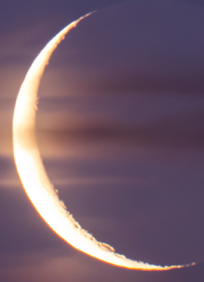
?
1
2
Yahuah’s
Word –
Ruach
ha Qodesh
3
From whom do you glean your instruction -
The Rabbi’s …??
Or…
The Scriptures?
The End

Slide 53


Questions?
Please send your comments or questions to
Timothy Astleford or Charlene Fortsch
tim@studythecalendar.com
charlene@studythecalendar.com

